Slide 1

RATIO-PROPORTION

Slide 2
Q1.One year ago the ratio of Ramu and Somu age was 6 : 7 respectively. Four years hence their ratio would become 7 : 8. How old is Somu?
A.24 years B. 30 years C. 32 years D. 36years
Q2.The sum of three numbers is 98. If the ratio of the first to second is 2 : 3 and that of the second to the third is 5 : 8, Then the second number is:
A.20 B. 30 C. 48 D. 58
Q3. If Rs. 872 is divided into three parts, proportional to ½:2/3:3/4 then the first part is:
A. 182 B. 190 C. 196 D. None

Slide 3
Q4.If P : Q = 8 : 15 and Q : R = 3 : 2, then find P : Q : R?
A. 8:15:7 B. 7:15:8 C. 8:15:10 D. 10:15:8
Q5.The salaries of A, B, C are in the ratio 2 : 3 : 5 . If the increments of 15%, 10% and 20% are allowed respectively in their salaries, then what will be the new ratio of their salaries?
A.3:3:10 B. 10:11:20
C. 23:33:60 D. 25:27:29

Slide 4
Q6.Present ages of X and Y are in the ratio 5 : 6 respectively. Seven year hence this ratio will become 6 : 7 respectively. What is X’s present age in years?
A.35 B. 42 C. 49 D. Can’t be determined
Q7.A and B have money in the ratio 2:1.If A gives Rs 2 to B ,the money will be in the ratio 1:1.What were the initial amounts they had ?
A.12 and 6 B.16 and 8 C.8 and 4 D.6 and 3

Slide 5
Q8.If A:B =3:4,B:C=5:7,C:D=8:9 then A:D is equal to ?
A.3:7 B.7:3 C.21:10 D.10:21
Q9.In a factory the salary of each worker is increased in the ratio 22:25 but the number of worker is decreased by 26 2/3 % ,the net effect on the salary is ;
A.16 2/3% decrease
B.11 1/9 % decrease
C.10% decrease
D.20% increase

Slide 6
Q10. The difference between a two-digit number and the number obtained by interchanging the digits is 36. What is the difference between the sum and the difference of the digits of the number if the ratio between the digits of the number is 1 : 2 ?
A. 4 B. 8 C. 16 D. 20
Q11. In a mixture 60 litres, the ratio of milk and water is 2 : 1. What quantity of water should be added so that the ratio becomes 1 : 3?
A. 80L B. 100L C. 120L D. 60L
Q12.In a bag, there are coins of 25 p, 10 p and 5 p in the ratio of 2 : 3 : 4. If there is Rs. 50 in all, how many 5 p coins are there?
A. 50 B. 100 C. 50 D. 200

Slide 7
Q13. Ratio of the earnings of A and B is 4:7. If the earnings A increase by 50% and those of B decrease by 25%, the new ratio of their earnings becomes 8:7. What are A’s earnings?
A.Rs.21000 B. Rs.26000 C. Rs.28000
D. Can’t determine
Q14.The students in three classes are in the ratio 4:6:9 .If 12 students are increased in each class the ratio changes to7:9:12 ,then the total number of student in the three classes before the increase is ?
A.95 B.76 C.100 D.114

Slide 8
Q15.The ratio of the incomes of A and B is 5 : 4 and the ratio of their expenditures is 3 : 2. If at the end of the year, each saves Rs. 1600, then the income of A is :
A.Rs. 3400 B. Rs. 3600 C. Rs. 4000
D. Rs. 4400
Q16.The ratio of the ages of a man and his wife is 4 : 3. After 4 years, this ratio will be 9 : 7. If at the time of marriage, the ratio was 5 : 3, then how many years ago were they married?
A.8 years B. 10 years C. 12 years
D. 15 years

Slide 9
Q17.A box has 120 coins of denominations 1 rs and 50 paisa only.The ratio of their respective values is 13:11.The number of one rupee coins is ?
A.65 B.66 C.77 D.78
Q18.The ratio of first and second class fares between two railway stations is 4:1 and that of number of passengers travelling by first and second classes is 1:40.If on a day 1,100 is collected as total fare,the amount collected from first class passengers is ?
A.315 B.275 C.137.50 D.100

Slide 10
AVERAGES
The result obtained by adding several quantities together and then dividing this total by the number of quantities is called Average.
Average= Sum of quantities / Number of Quantities
Important Points to Remember :
1.If all the numbers are increased by ‘a’ then their average is also increased by ‘a’.
2. If all the numbers are decreased by ‘a’ then their average is also decreased by ‘a’.
3. If all the numbers are multiplied by ‘a’ then their average is also multiplied by ‘a’.
4. If all the numbers are divided by ‘a’ then their average is also divided by ‘a’.

Slide 11
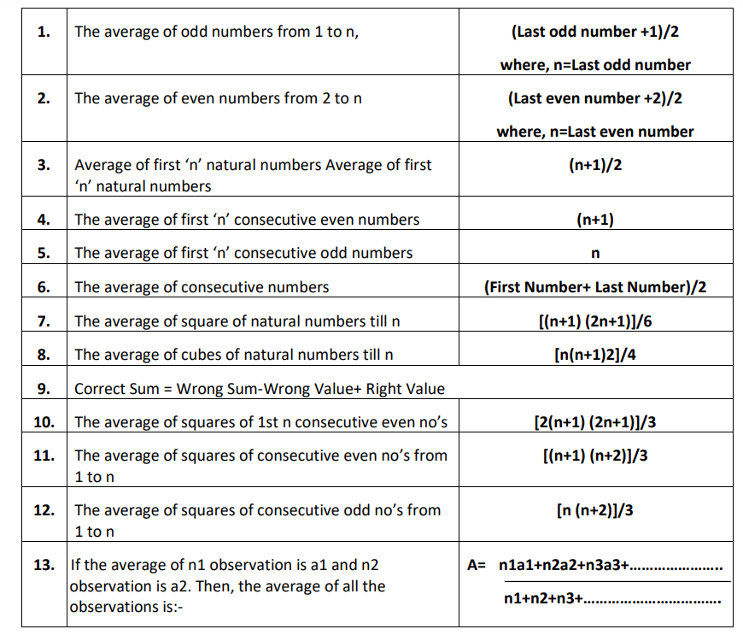
AVERAGES

Slide 12
BASIC
Q1.The average of four consecutive even numbers A, B, C and D is 55. What is the product of A and C?
A. 2812 B. 2912 C. 2512 D. 2069
Q2. Average of 4 consecutive odd numbers is 106. What is the third number in the ascending order?
A. 109 B. 107 C. 110 D. 120
Q3. The average of 5 positive integers is 55.8.If the average of first two integers is 4 and the average of fourth and fifth integers is 69.5. Then, find the third integer?
A. 42 B. 68 C. 72 D. 45

Slide 13
PARTIAL-AVERAGES
Q1.The average salary of 25 employees in a company per month is Rs.6000.If the manager’s salary is also added then the average increases by Rs.500.What would be the salary of the manager?
A. 17,000 B. 19,000 C. 21,000 D. 25,000
Q2. The average wages of a worker during a fortnight comprising 15 consecutive working days was Rs.90 per day. During first 7 days, his average wages was Rs.87 per day. And the average wages during the last 7 days wasRs.92 per day. What was his wage on the 8th day?
A.67 B. 79 C. 97 D. 98
Q3.40% of the employees in a factory are workers. All the remaining employees are executive. The annual income of each worker is Rs.390. The annual income of each executive is Rs.420.What is the average annual income of all the employees in the factory together?
A. 480 B. 580 C. 408 D. 690
Q4. The average annual income of Ramesh and Suresh is Rs.3800.The average annual income of Suresh and Pratap was Rs.4800.The average annual income of Pratap and Ramesh was Rs.5800.What is the average of the incomes of three?
A. 3600 B. 4800 C. 5200 D. 4600

Slide 14
Q5.On a School’s annual day sweets were to be distributed amongst 112 children. But on that particular day, 32 children were absent. Thus, the remaining children got extra 6 sweets. How many sweets did each child originally supposed to get?
A.15 B. 25 C. 30 D. 45
Q6.Arithmetic mean of the scores of a group of students in a test was 52.The brightest 20% of them secured a mean score of 80 and the dullest 25% a mean score of 31.The mean of remaining 55% is?
A. 52.5% B. 51.4% C. 62.5% D. 72.7%

Slide 15
WITH OR WITHOUT REPLACEMENT
Q1.When a student weighing 45 kg left a class, the average weight of the remaining 59 students increased by200 grams. What is the average weight of the remaining 59 students?
A.50 B. 57 C. 65 D. 80
Q2.There were 35 students in a hostel. Due to the admission of 7 new students the expenses of the mess were increased by Rs.42 per day while the average expenditure per head diminished by Re.1.What was the original expenditure of the mess?
A.240 B. 440 C. 420 D. 540
Q3.The average age of 40 students of a class is 18 years. When 20 new students are admitted to the same class the average age of the class is increased by 6 months. The average age of the newly admitted students is?
A. 19 Years 6 months B. 19 years C. 18 Years D. 20 years 2 months

Slide 16
MISTAKEN-AVERAGE
Q1.The average of 8 observations was 25.5.It was noticed later that two of those observations were wrongly taken. One observation was 14 more than the original value and the other observation was wrongly taken as 31 instead of 13.What will be the correct average of those 8 observations?
A.22.5 B. 21.5 C. 25 D. 24.5
Q2.The Arithmetic mean of 100 numbers was computed as 89.05.It was later found that two numbers 92 and83 have been misreads as 192 and 33 respectively. What is the correct Arithmetic Mean of the numbers?
A. 88.66 B. 88.55 C. 77.02 D. 90.54
Q3.In an examination, the average marks of all the students calculated to be 58 marks. It was later found that marks of 60 students were wrongly written as 70 instead of 50.If the corrected average is 55, find the total number of students who took the exam?
A.500 B. 450 C. 400 D. 420

Slide 17
PROBLEMS ON CRICKET
Q1.A cricketer has completed 10 innings and his average is 21.5 runs. How many runs must he make in his next innings so as to raise his average to 24?
A.50 B. 24 C. 49 D. 52
Q2.A cricketer had a certain average of runs for his 64th innings. In his 65th innings, he is bowled out for no score on his part. This brings down his average by 2 runs. His new average of run is?
A.135 Runs B. 128 Runs C. 150 Runs D. 132 Runs
Q3.The batting average of a cricket player for 64 innings is 62 runs. His highest score exceeds his lowest score by 180 runs. Excluding these two innings, the average of the remaining innings becomes 60 runs. His highest score is?
A. 212 Runs B. 220 Runs C. 214 Runs D. 241 Runs

Slide 18
MISCELLANEOUS
Q1.The average age of a family of 5 members is 20 years. If the age of the youngest member be 10 years then what was the average age of the family at the time of the birth of the youngest member?
A. 13.5 B. 14 C. 15 D. 12.5
Q2.The number of students in the three sections of a class are in the ratio 2:3:4. The average marksscored in each of these sections is in the ratio 4:3:1. By what percent is the average mark of the second section more than the class average?
A. 23.27% B. 28.57% C. 32.38% D. 36.74%
Q3.Nine persons went to a hotel for taking their meals. Eight of them spent Rs 12 each on their meals andthe ninth spent Rs.8 more than the average expenditure of all the nine. What was the total money spent by them?
A.117 B. 180 C. 150 D. 200
Q4.A ship 40 km from shore springs a leak which admits 3 ¼ Quintals of water in 12 mins.60 Quintals would suffice to sink the ship, but its pump can throw out 12 quintals of water in 1 hour. Find the average rate of sailing so, that it may reach the shore just it begins to sink?
A. 4.5 Km/hr B. 5.4 Km/hr C. 6 Km/hr D. 7 Km/hr

Slide 19
THANKYOU

